Slide 1
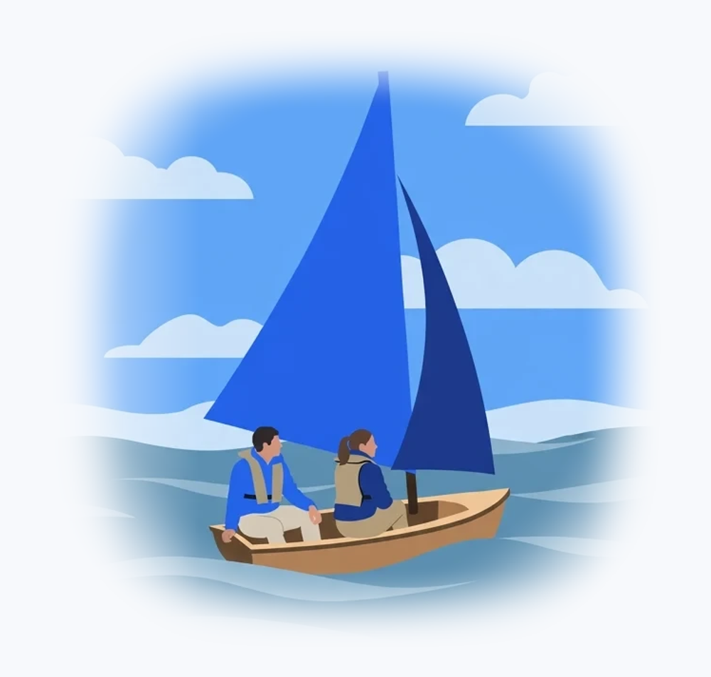
PRESENTATION
The water cycle
The Sun, clouds and the paths of
water
1

Slide 2
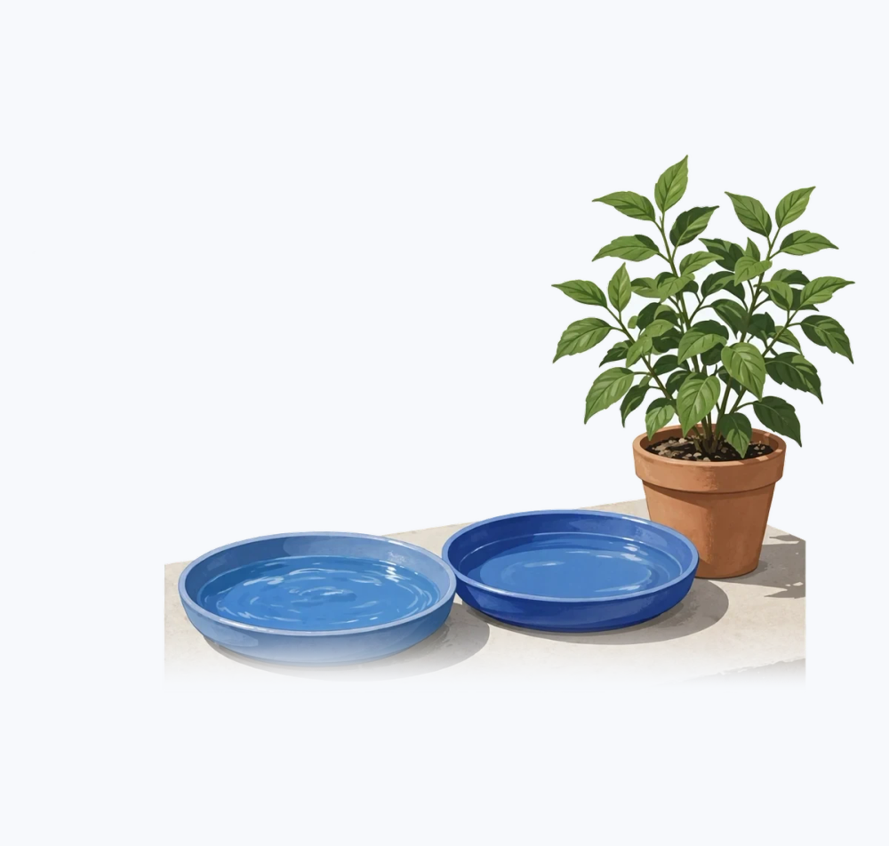
Water becomes
vapour
The Sun heats water.
Water vapour is invisible.
Plants also release vapour.
2
Notes:
The Sun provides the energy needed to evaporate liquid water in seas, lakes and soil. Heat turns this water into invisible vapour in the atmosphere. Plants also contribute by releasing water vapour through their leaves, a process called transpiration. Evaporation and transpiration therefore supply moisture to the air.

Slide 3
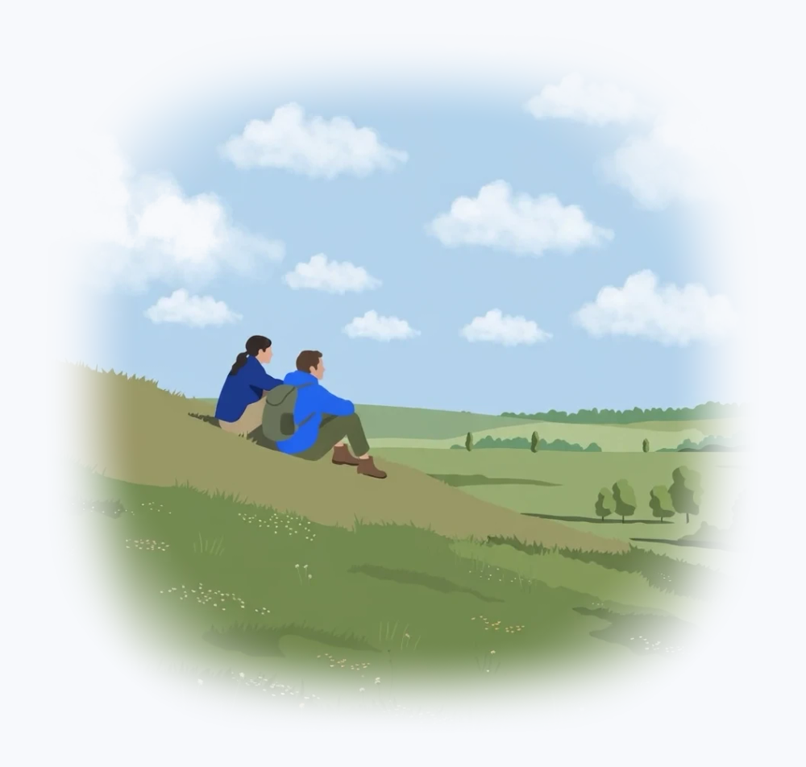
Clouds form
Moist air cools.
Vapour becomes droplets or ice.
These particles make the cloud
visible.
3
Notes:
As moist air rises and cools, invisible water vapour turns into tiny droplets or ice crystals. The accumulation of these particles makes clouds visible. A cloud is not made of visible vapour, but of these small droplets gathered together. Cooling therefore causes vapour to change state.

Slide 4
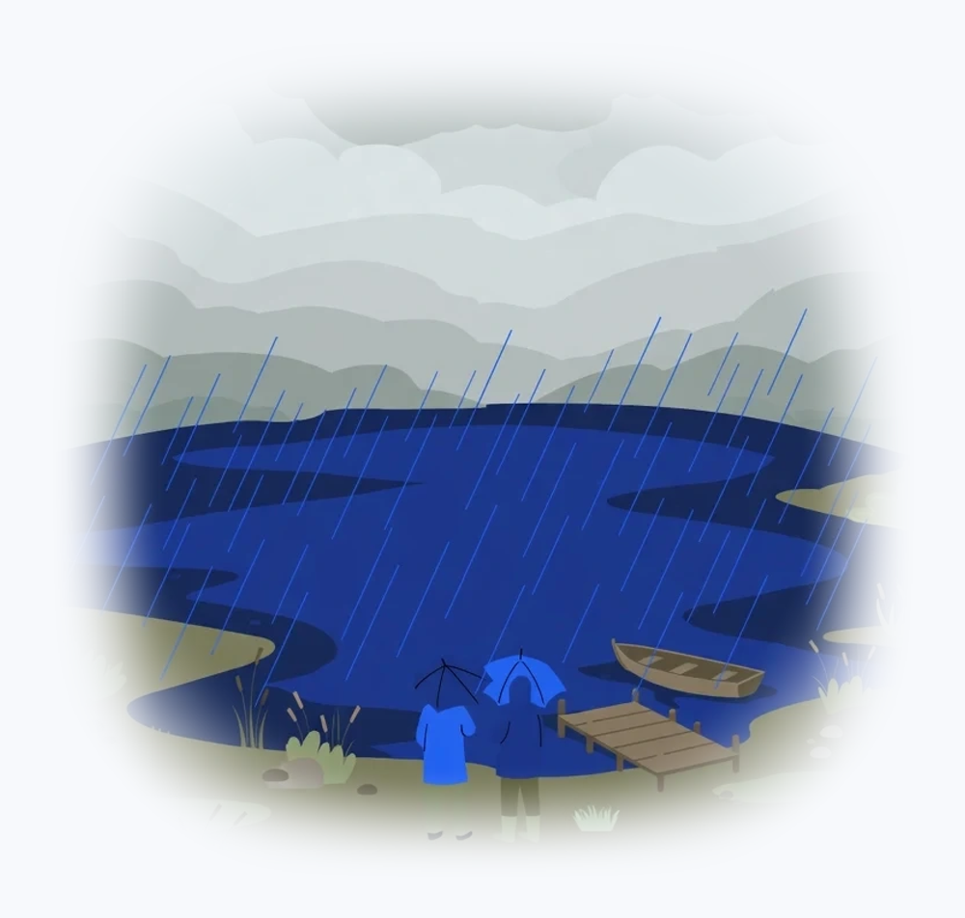
Precipitation
Droplets grow.
Water falls under gravity.
Rain, snow or hail, depending on
conditions.
4
Notes:
Inside clouds, droplets gather and gradually grow. When they become too heavy to stay suspended, they fall under gravity. Depending on temperature, they fall as rain, snow or hail. However, not all water returns immediately to the sea.

Slide 5
Two paths after rain
Infiltration
Runoff
Water enters the soil.
Water flows over the surface.
It may reach groundwater.
It reaches streams and rivers.
5
Notes:
On permeable ground, some rainwater infiltrates the soil and may reach groundwater. On slopes or impermeable ground, it flows across the surface into streams and rivers. Groundwater can also feed a spring or watercourse. These two paths show that the cycle does not follow a single route.

Slide 6
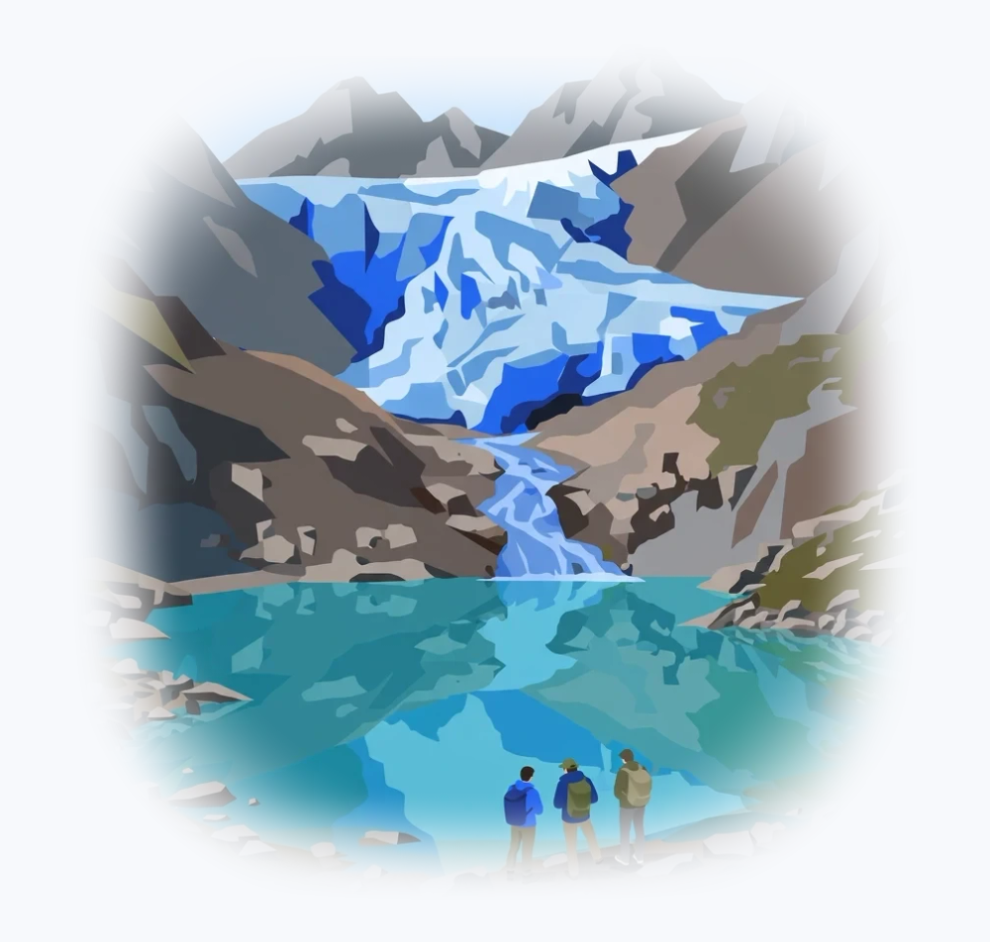
Water reservoirs
Oceans, lakes and glaciers.
Groundwater.
Very different storage times.
6
Notes:
Water can stay for different lengths of time in oceans, lakes, glaciers and groundwater. Each reservoir is a different stage in water's journey. The same drop can take several paths and remain stored for a long time before moving on. The water cycle is therefore a set of varied routes rather than a simple loop.

Slide 7
Two simple observations
Evaporation
Condensation
Two dishes: sun and shade.
A glass of very cold water.
Mark the starting level.
Drops on the outside.
Compare a few hours later.
They come from moisture in the air.
7
Notes:
To observe evaporation, place two dishes with the same amount of water, one in sunlight and the other in shade, then compare their levels after a few hours. To observe condensation, look at the droplets forming on the outside of a glass containing a cold drink. They come from moisture in the surrounding air cooling against the glass. These two simple experiments illustrate changes in the state of water.

Slide 8
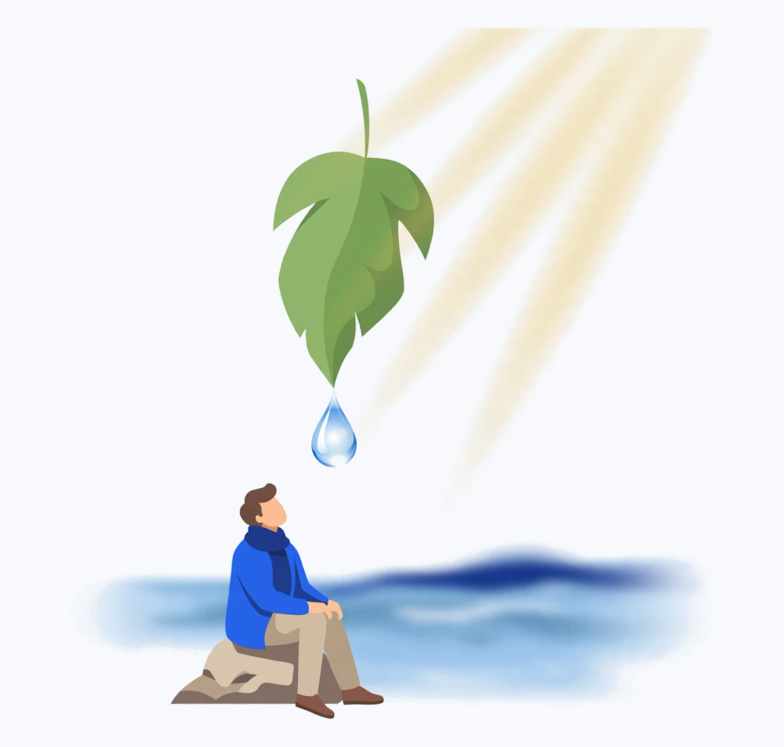
One water, many
paths
01
Water changes state and
location.
02
The Sun supplies energy.
03
Gravity drives water flow.
8

