Slide 1
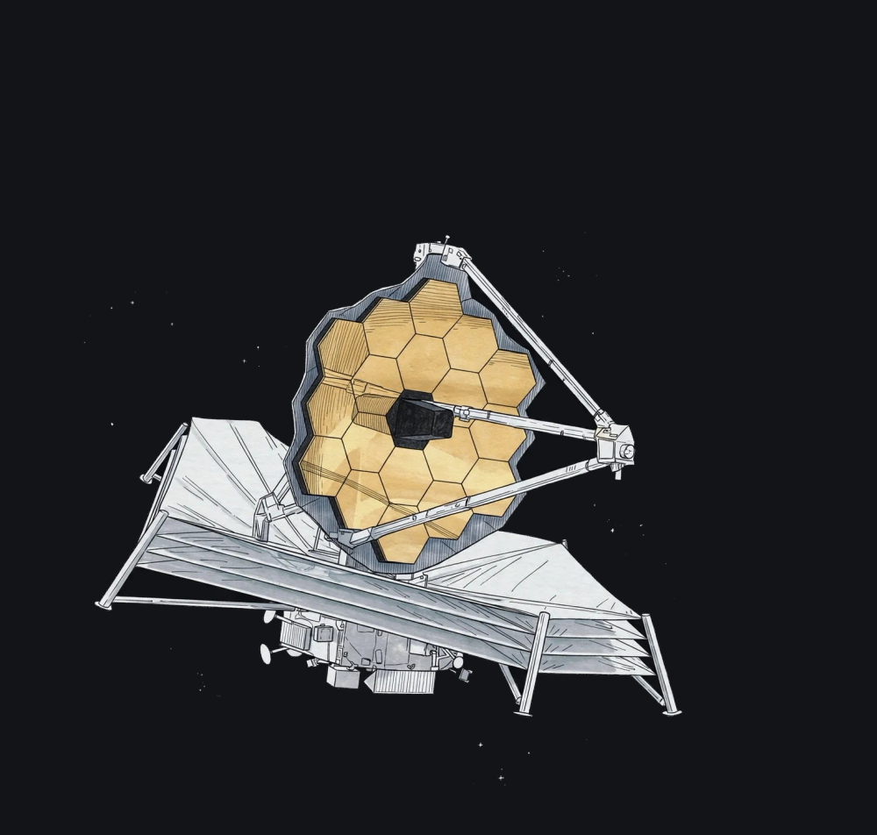
The James Webb
Space Telescope
Unlocking the secrets of the
earliest galaxies and exploring
the origins of the Universe
Astronomy
Astrophysics
Space Sciences
1

Slide 2
Overview of This Space Exploration
01
Genesis and Key Figures
Launch, international partnerships, and
the scale of an extraordinary mission
02
Why Observe in the
Infrared?
Cosmic expansion, redshift, and dust
penetration
03
Technological Feats
Origami mirror, thermal sunshield, and
strategic orbit at the L2 point
04
Instruments and
Discoveries
Onboard cameras, breathtaking first
images, and exoplanet research
2
Notes:
Here is our roadmap for exploring this extraordinary scientific journey. We will first look at the mission's context and its launch on Christmas Day 2021. Next, we will explore why infrared observation is essential for peering into the far reaches of the cosmos. Finally, we will detail the onboard technology and the telescope's revolutionary first discoveries.

Slide 3
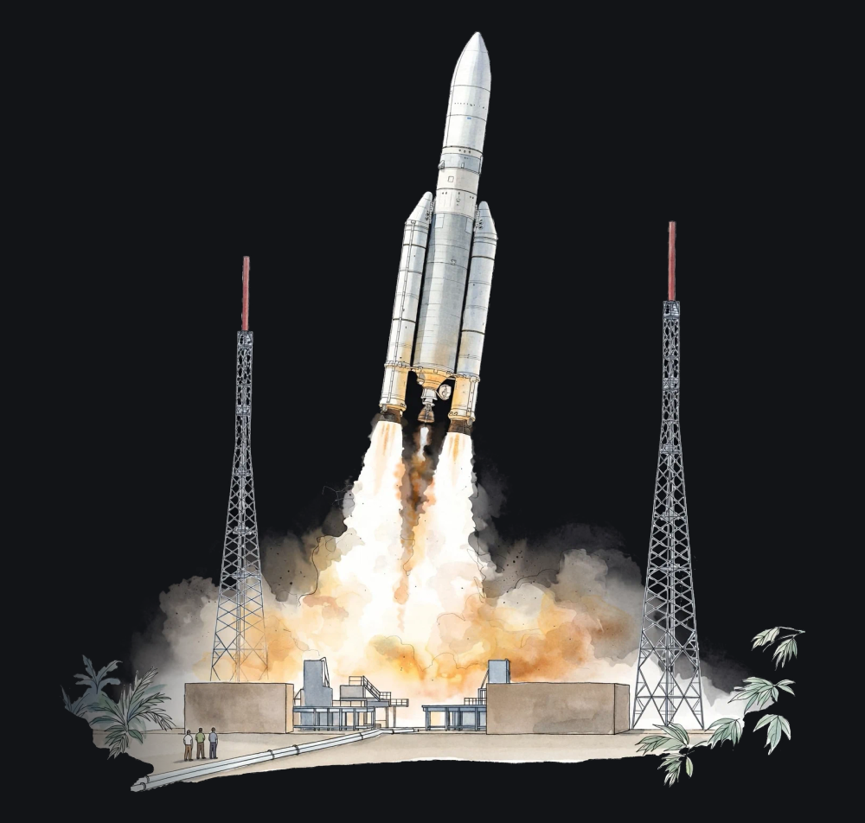
NEW SECTION
An Unprecedented
International Space
Odyssey
3

Slide 4
The James Webb Telescope in 4 Key Figures
≈ $10B
6.5 m
1.5M km
344
Estimated
total cost
Primary
mirror
(Hubble: 2.4
m)
Distance
from Earth,
at the L2
point
Single points
of failure
during
deployment
4
Notes:
JWST represents one of the world's most ambitious scientific partnerships, uniting NASA, ESA, and ASC. Launched on December 25, 2021, by an Ariane 5 rocket from Kourou, it cost nearly $10 billion. Its scale is extraordinary: its giant mirror gathers light 1.5 million kilometers away from us. Engineers had to overcome 344 critical steps where a single error would have doomed the entire mission.

Slide 5
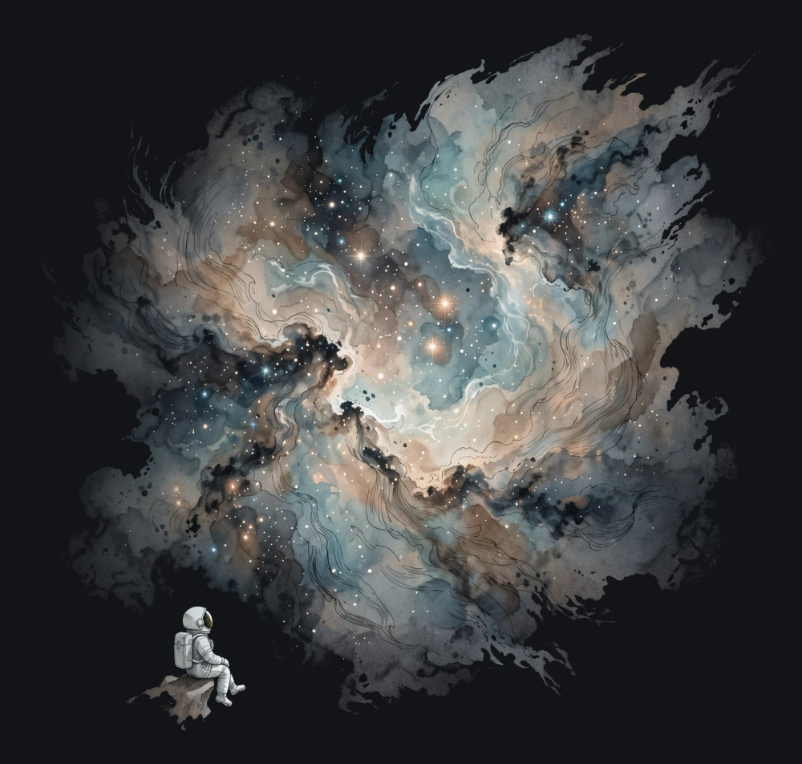
NEW SECTION
Infrared Vision:
Looking Back in
Cosmic Time
5

Slide 6
The Redshifting of Light
KEY TAKEAWAY
Cosmological Redshift
Light from distant galaxies has been traveling for
more than 13 billion years. Due to the expansion of
the Universe, its wavelengths stretch: radiation once
emitted in the visible spectrum reaches us today in
the form of infrared radiation.
6
Notes:
Visible light is no longer enough to observe the first galaxies that emerged after the Big Bang. Over billions of years, the expansion of space has stretched light waves into the infrared range. Moreover, infrared radiation can pierce through dense dust clouds, enabling Webb to peer straight into the heart of stellar nurseries.

Slide 7
The Vital Advantages of the Infrared Spectrum
Webb observes the electromagnetic spectrum between 0.6 and
28.5 micrometers, spanning from visible red to mid-infrared.
Infrared radiation cuts through the clouds of interstellar dust
that conceal stellar birthplaces.
It allows direct observation of galaxies formed just a few
hundred million years after the Big Bang.
It provides unprecedented spectral resolution to detect
molecules in the atmospheres of distant exoplanets.
7
Notes:
Infrared represents a true revolution for modern astronomy. Spanning 0.6 to 28.5 micrometers, Webb observes regions that were previously completely opaque. It pierces the dusty cocoons where stellar and planetary systems take shape. This spectrum also makes it possible to chemically analyze the atmospheres of other worlds.

Slide 8
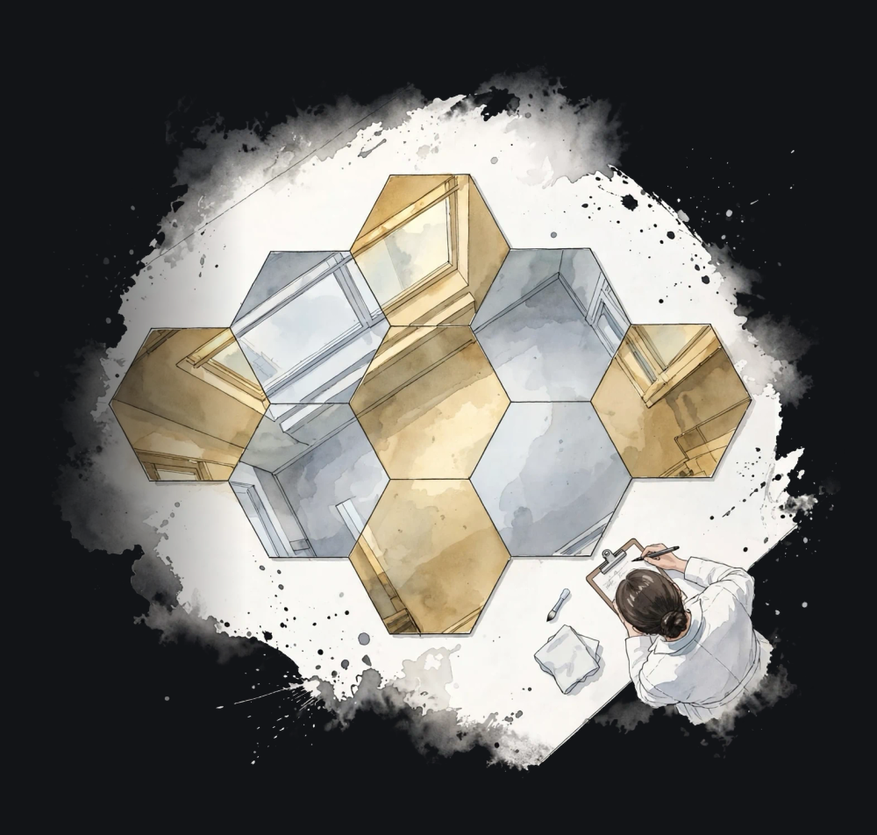
NEW SECTION
Extreme Engineering:
Giant Mirror and
Cryogenics
8

Slide 9
Technical Face-Off: Hubble vs. Webb
Feature | Hubble (1990) | James Webb (2021)
Mirror Diameter | 2.4 meters | 6.5 meters
Collecting Area | Approximately 4.5 m² | Approximately 25 m² (five times larger)
Light Ranges | Ultraviolet and visible (minimal infrared) | Near- and mid-infrared (from 0.6 µm)
Orbital Location | Low Earth orbit (540 km) | Lagrange point L2 (1.5 million km)
Crewed Servicing | Serviceable by space shuttle | No crewed servicing possible
9
Notes:
This table highlights the technological leap between these two generations of observatories. While Hubble's mirror measured 2.4 meters with a surface area of 4.5 m², Webb's reaches 6.5 meters and 25 m², offering five times the light-collecting power. Located in low Earth orbit, Hubble could be visited and repaired by astronauts. Webb, however, is stationed at the L2 point 1.5 million kilometers away, which rules out any direct servicing.

Slide 10
An Origami Mirror and a Sunshield
18 hexagonal segments made of
solid beryllium.
Sunshield composed of 5 Kapton
layers measuring the size of a tennis
court (21 m × 14 m).
Coated with a thin layer of gold
optimizing infrared reflection.
Maintains the shaded side below 50
kelvins, or approximately −223 °C.
Mirror folded to fit inside the Ariane 5
fairing, then deployed in space.
Total insulating shield against the
Sun, Earth, and Moon, which are
always aligned.
Nanometric alignment of mirrors to
function as a single optic.
Additional cryogenic cooling for the
MIRI instrument down to 7 kelvins.
10
Notes:
The dimensions of the primary mirror prevented it from being launched as a single piece: it had to be designed like mechanical origami made of 18 gold-plated beryllium segments. To detect faint infrared sources without being blinded by its own heat, the telescope shelters behind five Kapton layers. This gigantic sunshield drops the temperature to −223 °C, and down to 7 kelvins for the MIRI instrument via a cryocooler.

Slide 11
Space Deployment Timeline
December
25, 2021
January 2022
January 24,
2022
Spring 2022
July 12, 2022
Launch by
Ariane 5 from
Kourou.
Sunshield and
mirror
deployment.
Arrival in orbit
around L2.
Cooling of
detectors and
micrometric
alignment of
the 18 gold
segments.
Release of the
very first
full-color
scientific
images by
NASA.
11
Notes:
Deploying the JWST involved weeks of intense suspense for the international astronomical community. Following a surgically precise launch on December 25, 2021, the critical phases unfolded seamlessly. On January 24, 2022, the spacecraft reached its target orbit at the L2 point. Several months of optical alignment and cooldown then paved the way for the unveiling of the first global images in July 2022.

Slide 12
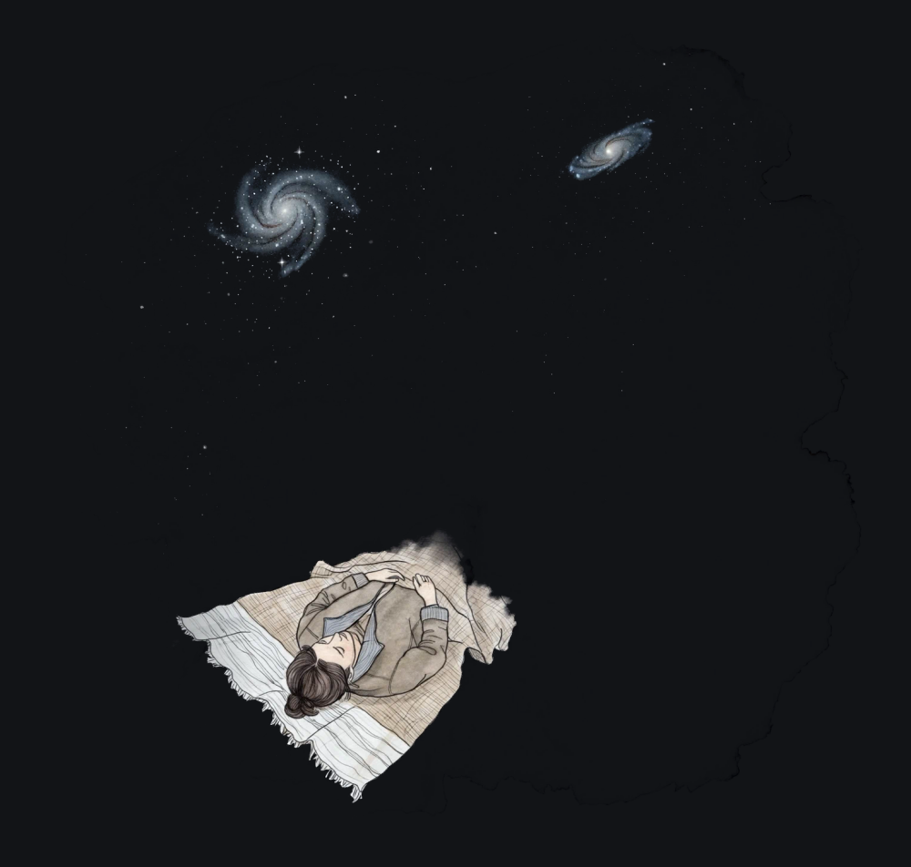
NEW SECTION
The Giant's Eyes and
Discoveries
12

Slide 13
Four Cutting-Edge Scientific Instruments
NIRCam
NIRSpec
Near-infrared camera. It captures most of
the spectacular imagery and detects the
earliest stars.
Spectrograph capable of splitting and
analyzing light from dozens of objects
simultaneously.
MIRI
NIRISS & FGS
Mid-infrared camera and spectrograph,
actively cooled to 7 kelvins to pierce through
the densest dust.
Combines a high-precision spectro-imager
with the fine guidance sensor that ensures
ultra-stable telescope pointing.
13
Notes:
The four onboard instruments complement each other to scan the infrared spectrum. NIRCam delivers astonishingly sharp images in the near-infrared, while NIRSpec allows the simultaneous study of multiple galaxies using microshutters. MIRI probes the mid-infrared at extremely low temperatures, and the FGS sensor paired with NIRISS guarantees the targeting stability vital for long exposures.

Slide 14
Hubble and Webb: A Collaborative Vision
Hubble: The Visible Universe
Webb: The Deep Universe
Reveals light from hot stars
and ionized gas.
Pierces through opaque
curtains of dust.
Captures fine details in
ultraviolet and visible light.
Unveils forming stars and
extremely distant objects.
Provides morphological
context for nearby galaxies.
Analyzes the chemical
composition of targets using
infrared.
14
Notes:
Far from competing, Hubble and Webb form a remarkable and complementary duo. Hubble offers an unrivaled view of hot gas activity and bright stars across the optical and ultraviolet spectrum. Webb adds the thermal and deep-space dimension, revealing what lies hidden behind stellar cocoons. Researchers frequently combine data from both observatories to gain a complete picture of cosmic phenomena.

Slide 15
Major First Discoveries
Ultra-deep field image of galaxy cluster SMACS 0723 revealing dramatic
gravitational lenses.
Unprecedented details within the Carina and Southern Ring Nebulae.
Precise observation of cosmic interactions at the heart of Stephan's
Quintet.
Detection of carbon dioxide (CO₂) in the atmosphere of exoplanet
WASP-39 b.
Identification of galaxies that formed just a few hundred million years after
the Big Bang.
15
Notes:
From its very first images released on July 12, 2022, the JWST demonstrated spectacular performance. It revealed the structures of the Carina Nebula with unprecedented clarity. On the cosmological front, Webb cataloged early galaxies that challenge several theoretical models. It also confirmed the presence of carbon dioxide in the atmosphere of the exoplanet WASP-39 b.

Slide 16
Longevity Beyond Expectations
KEY TAKEAWAY
Designed for at least five years, with a goal of ten, the
mission saved fuel thanks to a precise launch. NASA
estimates it has enough for well over ten years of
science operations.
16
Notes:
This is one of the mission's finest surprises: the remarkable accuracy of the Ariane 5 launch on December 25, 2021, saved onboard propellant. While the baseline lifespan targeted five to ten years, fuel reserves will allow the telescope to operate well beyond a decade. Astronomers around the world will thus benefit from an extended observational window onto the cosmos.

Slide 17
Key Takeaways on the James Webb Telescope
01
A major technological leap with its 6.5 m deployable gold
mirror and cryogenic sunshield.
02
Infrared vision enables it to peer through dust and observe the
earliest light in the Universe.
03
A collaboration among NASA, ESA, and CSA, expected to
operate for well over ten years.
04
Groundbreaking discoveries already made regarding exoplanet
atmospheres and the first galaxies after the Big Bang.
17

